Slide 1
Portofolio Performance
Group – 9
Aamil Khan Mahar

Slide 2
Passive portfolio

Slide 3
Portfolio mandate
The mandate of this Portfolio was to see if following the market is a good idea.
The Ideology was to follow KSE-30.
- The Rationale for this portofolio is that the market is an Efficient market.
- Beta Grazing is the only option in this Market.

Slide 4
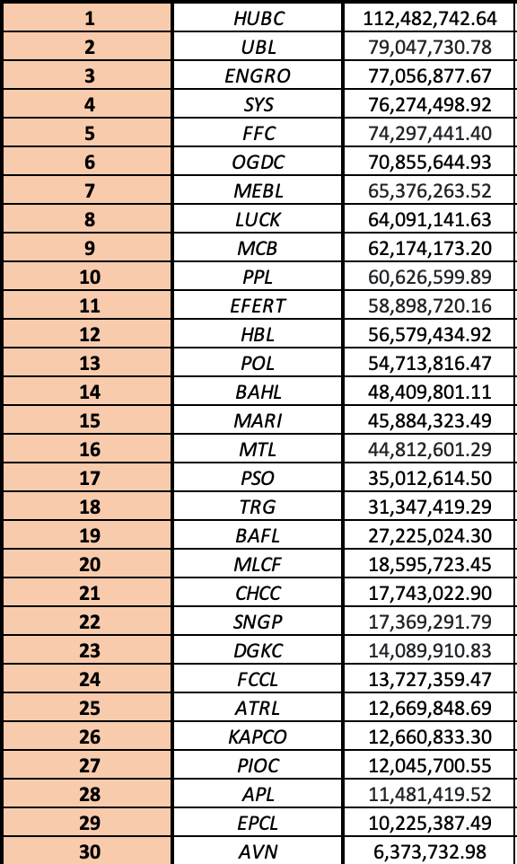
Portfolio Stocks

Slide 5
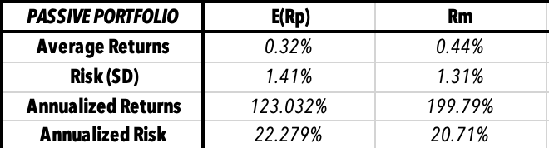
Expectations vs reality
Our Expectation was that KSE-30 and our index portfolio would provide us with the same return and risk.
The reality was that our portfolio was not able to mimic the Market correctly.
This provides us with the conclusion that our market is not an efficient market.
It furthers prompts us to go for an active investment strategy instead of a passive one.

Slide 6
Active - 2

Slide 7
Portfolio mandate
The Construction Ideology of thos portfolio was to see if I am a risk averse investor or a risk loving investor.
To achieve this I am for stocks that were going to provide me with the most returns in the near future instead of going for a long term goal

Slide 8
Portfolio stocks
The Stocks I choose for my portfolio were the following:
KTML
AICL -> Later replaced with TOWL
AIRLINK
PPL
MEBL

Slide 9
Expectations vs reality
As I expected that our strategy of going for short term gain would be the best strategy in the currently highly volatile market.
The results support my strategy as out of the three portfolios Active – 2 was the best performing portfolio.

Slide 10
ACTIVE - 3

Slide 11
Portfolio mandate
The Construction Ideology of this portfolio was to create a well deversified portfolio that could beat the market.
The rationale for choose the stocks in this portfolio was to add a mix of growth stock and value stocks – which would help in keeping the volatility in a good region and to get those alpha returns

Slide 12
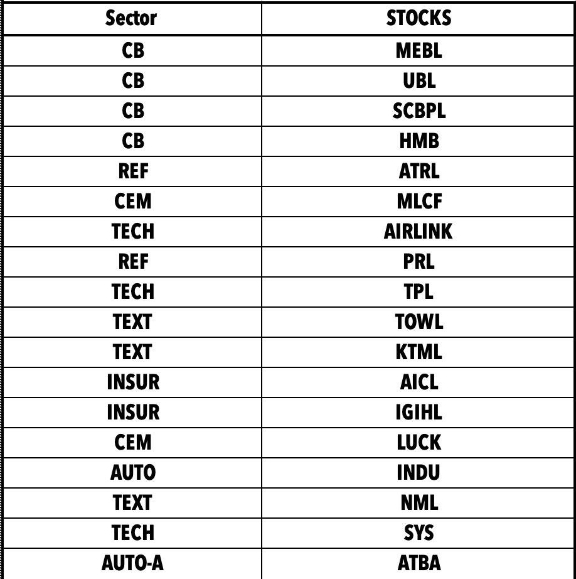
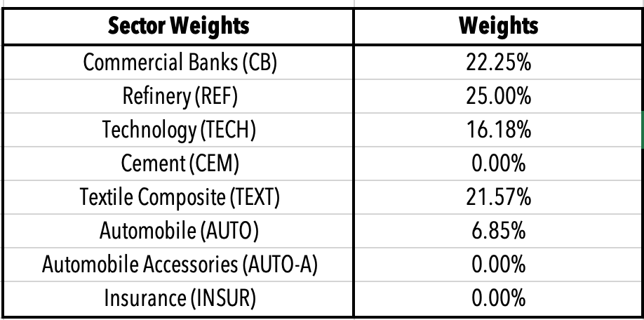
PORTFOLIO STOCKS AND SECTORS

Slide 13
PORTFOLIO Results
The expectation we set for this portfolio was to beat the market and get the ALPHA returns as an investor investing in an inefficient market would get.
But the portfolio ended up giving us the same results as our passive portfolio which means that our risk in this portfolio was highly diversified.
This leads to the conclusion that our choice of stocks was not a good one to aim for ALPHA Returns and instead it was similar to the market portfolio that we created for KSE-30

